Slide 1
Methods in Quantitative Analysis
MST, PMFG, TVP-VAR Modelling, TCI, QoQ Framework
Jack Wu, Quantitative Analyst Intern, Icarus Fund LLC.

Slide 2
1. Minimum Spanning Tree (MST)
Planar Maximally Filtered Graph (PMFG)
2. Quantile-on-Quantile (QoQ) Framework
3. Total Connectedness Index (TCI)
4. Time-Varying Parameter VAR (TVP-VAR) Model

Slide 3
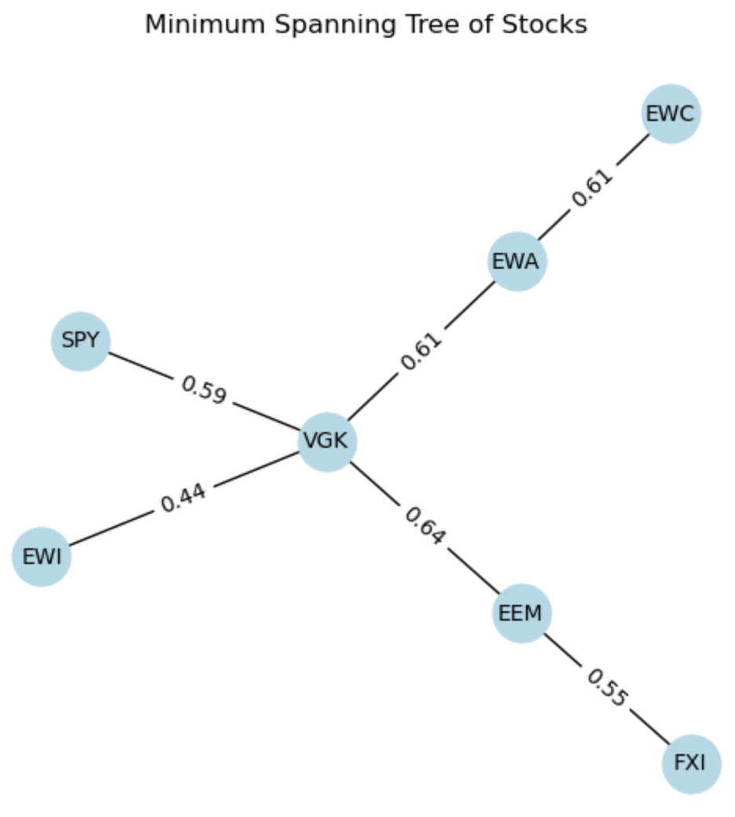
Minimum Spanning Tree (MST)
A minimum spanning tree is essentially a subset of a graph with weighted edges that minimizes the total sum of the weights of the edges.
Fitting a set of assets with an MST reveals the main internal structure in terms of correlation, where correlation acts as the weights.
Above is the MST for the set of indices given, where the values on the edges represent correlation. Note that this analysis and all those that follow used the adjusted close price data of the indices.

Slide 4
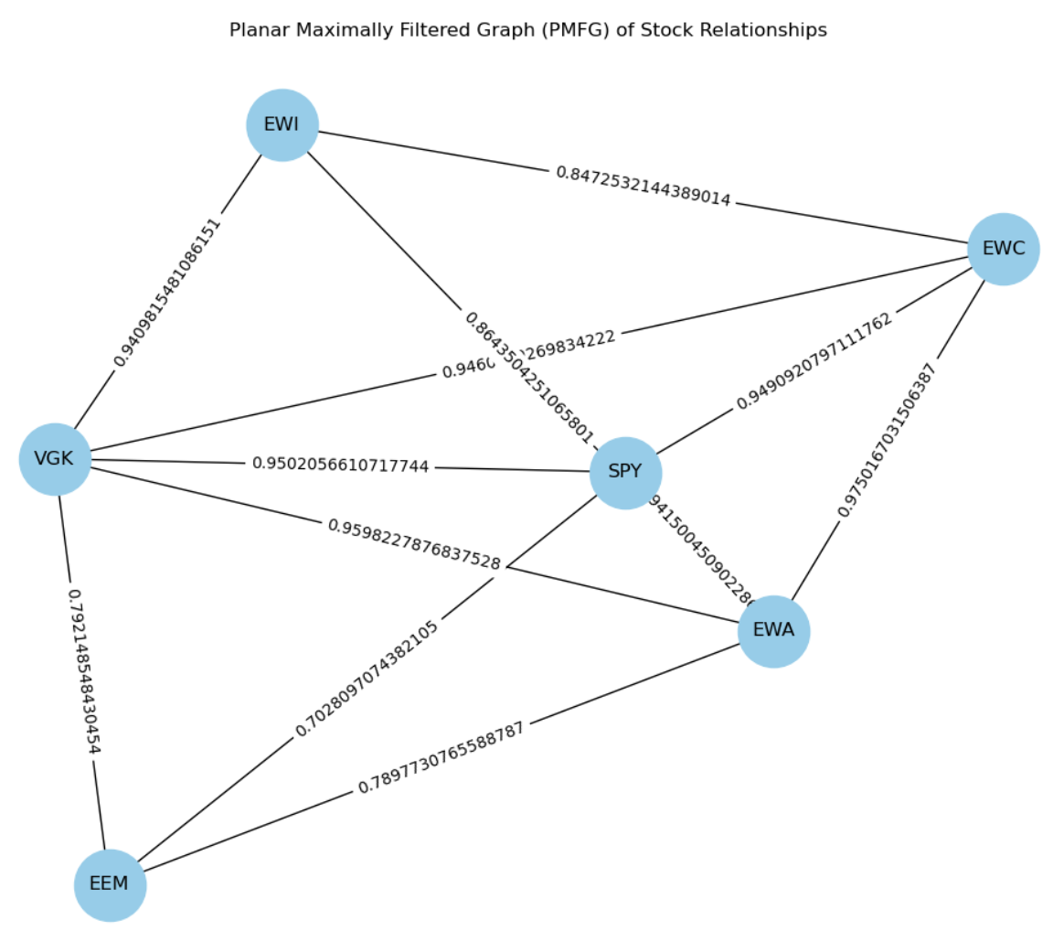
From the MST, we notice that the European VGK index is the root of the structure, and that the other indices branch out from this root. We interpret this as saying that the movement of the rest of the indices are most highly correlated with that of VGK’s.
We also observe that there are layers. The immediate neighbours of VGK are SPY, EWI, EWA, and EEM. From EWA branches EWC, and from EEM branches FXI.
This suggests that EWC and FXI are not highly directly correlated with VGK. Instead, they are correlated with EWA and EEM respectively. Because these two latter indices are directly connected to VGK, there is indirect correlation with the former two indices.
We now examine a PMFG:

Slide 5
Side-by-side Comparison

Slide 6
The PMFG network is much more complex. This was expected, since the PMFG graph was designed to capture more relationships between nodes in a graph.
We observe similarities between the MST and PMFG. Firstly, in the PMFG, notice that all the indices share an edge with VGK with relatively high correlation. This is consistent with the MST, which identified VGK as the principal root.
A major difference is the total absence of the Chinese FXI index in the PMFG. Recall that a PMFG can only add edges when planarity is maintained; a possible explanation is that connections from the FXI index break that planarity.
Another possible explanation is that the FXI index is too uncorrelated with the rest of the structure and is redundant. A PMFG, although more liberal in the connections it draws, still only contains the central structure.
Ultimately, the key observation to make is that the PMFG provides much more insight into the structure of the assets than the regular MST. There exists correlation connects previously indiscernible.

Slide 7
Total Connectedness Index (TCI)
The TCI is calculated using the covariance matrix between assets and is a measure of overall correlation in that set of assets.
The TCI of this set of indices was found to be 0.498, found by fitting a VAR model to the set of time-series data.
This proportion indicates that within this set of indices, 49.8% of the adj. close price movement can be attributed to a correlation with other members of the set. This is a moderate level.
We conclude that the systemic risk is moderate. Although the 49.8% figure indicates relatively high connectedness, and hence relatively high exposure to risk, it also means that roughly 50% of the index adj. close prices move independently. This minimizes the risk of major loss due to risk.
There are several risk management strategies that could be effectively utilized to minimize the risk with this moderate TCI. The first is diversification. Since there is moderate risk in investing jointly in all the major stock indices in the world, it may be best to explore other investment opportunities aside from equity, such as bonds, real estate, etc. Another is stress testing, which can really put into perspective the TCI of 0.498 and lead to better investing strategies.

Slide 8
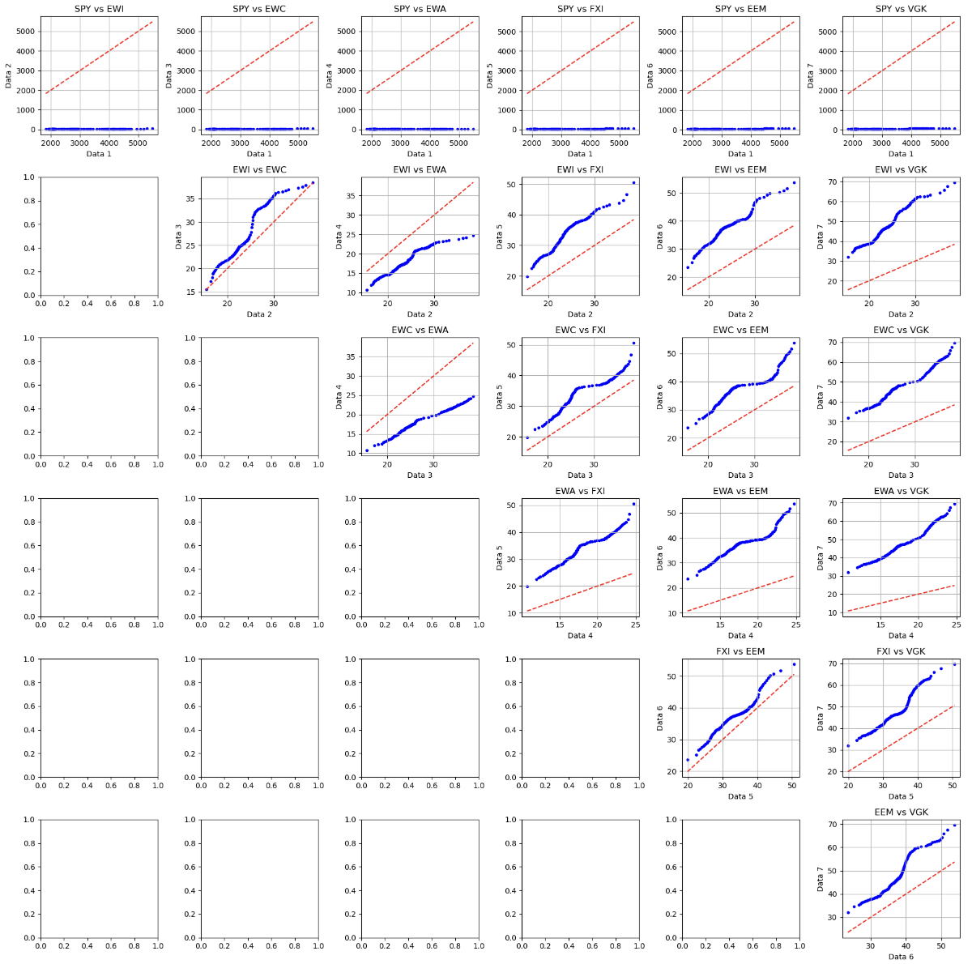
QoQ Framework
A quantile-on-quantile plot provides insight into the correlation of the different quantiles of adj. close price of one asset with those of another.
This is a panel of quantile-on-quantile plots for each pair of indices:

Slide 9
When analyzing QoQ plots, we are to assess the degree to which the plotted curve from our data (blue) aligns with the straight line (red). Higher deviation from the straight line indicates less similarity in terms of the distribution of the two stocks. More specifically, the “S” shape indicates deviation in tail behaviour as well as central quantiles.
Upon qualitative observation, there are only two pairs of stock indices that demonstrate similarity: EWI and EWC, FXI and EEM. These plots can be found along the main diagonal of the panel. We conclude that the distribution of adjusted close price of EWI and FXI are correlated with the distribution of adjusted close price of FXI and EEM respectively. In other words, finding adjusted close prices in one particular quantile in one of the pairs is correlated to the adjusted close price of another index in the corresponding quantile.
The other index pairings deviate significantly from the straight line, indicating significant differences in adjusted close price distribution.
To analyze performance under volatile/stressed market conditions, we consider the parts of the blue curves near the beginning and near the end. These parts represent the tails of the distribution, which is where volatile market conditions occur.
We will perform this analysis on the two pairs deemed to be correlated. Although, this can be generalized to analyses of the other plots.

Slide 10
Notice that both in the lower and upper tails, the blue line converges to the central red line well. This indicates that under extreme market conditions, the two stocks behave similarly. In calm market conditions (around the middle, closer to the top), there seems to be a lack of correlation between the two assets.
Under extreme conditions in the tails, the distributions are correlated, similar to the previous pair. However, the correlation in this pair under calm market conditions around the centre is significantly better behaved than that of the previous.

Slide 11
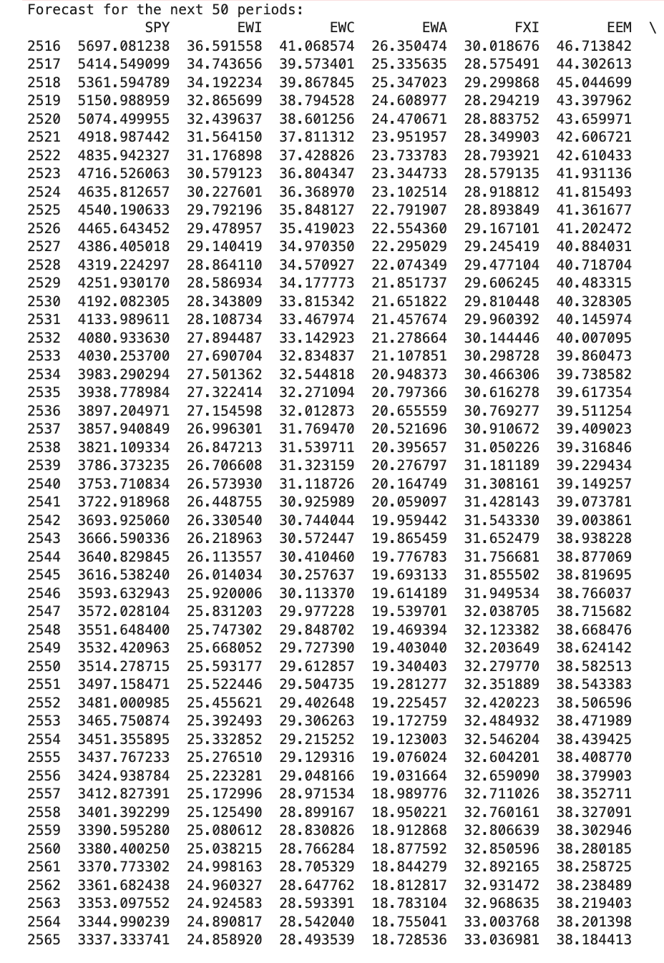
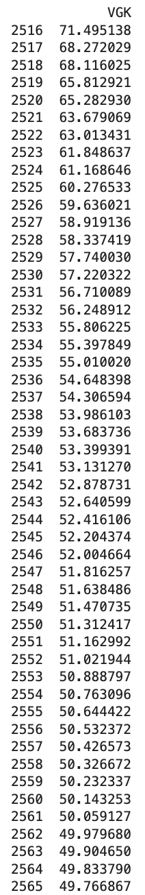
TVP-VAR Model
We fit a TVP-VAR model and find the following forecast for the next 50 days:
Interestingly, all adjusted close prices across all the indices are predicted to strictly decrease in the near future.
To analyze the change in correlation, one simply has to take this forecast dataset and apply the algorithm to calculate the TCI. Comparing the TCI with historical values can determine how the correlation has evolved.

